Slide 1
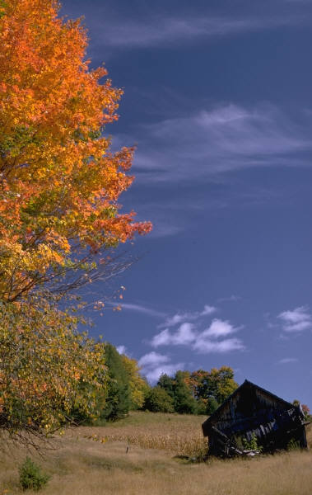


LOGAN WELLS EVENTS LISTINGS AS OF 11/5/13
Weds., Nov. 6, 2013 6-9 pm Logan Wells .....OLESIA’S PLACE – 11204 Royalton Rd., N. Royalton 440-877-9054
Thurs., Nov. 7, 2013 7:30 – 10:30 pm VOSH – 18515 Detroit Rd., Lakewood, OH 44107 216-221-3500
Fri., Nov. 8, 2013 9pm-1am THE LAMPLITER – 6339 Old York Rd., Parma Hts., OH 440-845-7897
Sat. Nov. 9, 2013 9-mid INFERNO LOUNGE – Yorktown Lanes – 6218 Pearl Rd., Parma Hts., OH 440-886-5300
Fri. Nov. 15, 2013 9-mid LARRYS BAR -9750 Old Eight Rd. #1, Northfield, OH 44067 330-467-8869
Sat. Nov. 16, 2013 8-11pm BOOMERS – 305 Broad St., Elyria, OH 440-322-9144
Monday, November 18, 2013 7:30-10:30 pm SAVANNAH’S – 30676 Detroit Rd., Westlake, OH 440-892-2266
Fri., Nov. 22, 2013 7-11 SANDUSKY EAGLES – 1235 W. Perkins, Sandusky, OH 44870 419-625-8911 open to public!
Sat., Nov. 23, 2013 8-11pm CUYAHOGA FALLS AMERICAN LEGION -
Weds., Nov. 27, 2013 8-11pm or later! THANKSGIVING EVE! Logan Wells & Jerry Colosimo perform at TRIPPS BAR (FORMERLY JOCKO’S) – 1100 Royalton Rd.., Broadview Hts., OH 440-877-2622 Come kick off your holiday weekend with us!
Sat., Nov. 30, 2013 9-Mid FRONT ROW BAR – 15119 Snow Rd., Brookpark, OH 216-433-0060
**Click each page to forward to next page
*****check the website as new bookings are coming in daily!!!
All dates and times subject to change! Please check with venue to confirm date and time before driving out to a gig!!
For information on Logan Wells & bookings,
contact Logan Wells Productions @ 440-582-3996
Email: SavocaProd@aol.com
CHECK OUT THE WEBSITE: www.LoganWells.com
Logan Wells/ PO Box 33453/ Cleveland, OH 44133

Slide 2

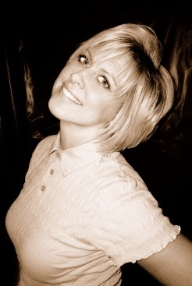

You can pick up Logan’s CD’s at any of Logan’s concert appearances, or order by mail for VISA/ MC orders.
Or go to CDbaby.com –type Logan Wells in search box
Tribute to Patsy Cline/ Been There, Done That / Let It Shine/ Country Classics/ Merry Christmas Darling
$ 15 ea. plus $3 ea s/h or $4.00 for priority mail.
Send check or money order to Logan Wells, PO Box 33453, Cleveland, OH 44133
We accept credit cards when purchasing at a concert event!!
You can check for updates on bookings at www.LoganWells.com - click on 2013 events listing link!
also, you can pick up Logan Wells cd’s at:
The Music Box - 8062 Columbia Rd., Olmsted Falls, OH 44138 440-235-1625
Please keep us in mind for any club/lounge, casino, cruises, city concerts/ festival entertainment, special events/weddings/ parties/ corporate functions! We play a wide variety of music as you can see from our 650+ song list below....we play the crowd, play what they want to hear, take requests, keep the sound at a comfortable level, new lighting, laser lighting and bubble machine all adds to the fun and makes a party atmosphere that encourages dancing and eating/drinking and sticking around for lots of fun!
Pop, Country, Folk, Blues, Rock, Jazz, Oldies, 70/80's dance music, this dynamic duo will leave you wanting more! Listen below:
click here for mp3 promo - variety music show snippets
Click below for a video presentation promo:
LOGAN WELLS & JERRY COLOSIMO PROMO VIDEO
Variety music!!
For booking info call 440-582-3996 or John Tag 216-650-4099

Slide 3
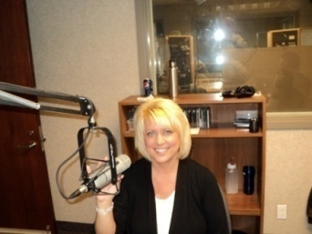
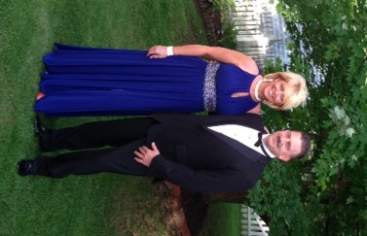
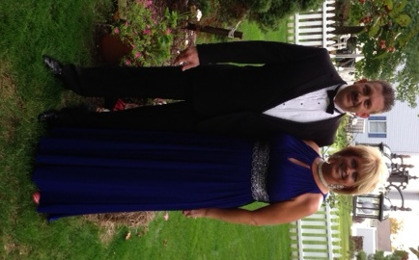
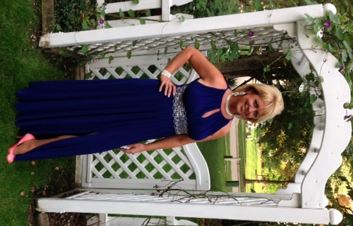
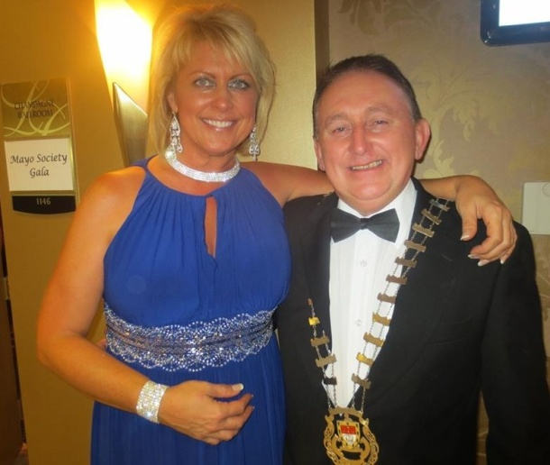
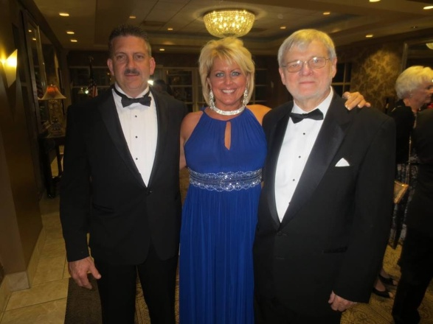
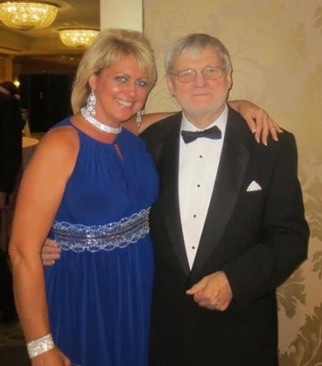
Check out on youtube.com & facebook- new! Click here Logan Wells – The Singing Chef & Homemaker
JERRY QUINN'S IRISH SHOW WHK - 1420 AM 10 am - Noon
Every Sunday Morning request line 216-901-0945**Call or email and ask for your favorite Logan Wells tune!
Logan Wells appeared on Gerry Quinn's Irish Radio program on WHKradio.com
1420 AM this past Sunday Dec. 2, 2012. If you would like to hear the guest appearance
and interviews, songs from the new Christmas CD, go http://www.quinnirishradio.com/archives.php
The recorded archive of the show is now available at the link below Dec. 2nd show..... ;o)
PICS FROM THE MAYO BALL 2013 AT LA CENTER, WESTLAKE OH
John O’Malley, Mayo County Council
John Tagliarini, Logan Wells, Gerry Quinn - Quinn Irish Radio WHK-1420AM
And President of the Mayo Society of Greater Cleveland
What a fabulous event at La Center in Westlake, OH –
Mayo Ball 2013 Elegant, black tie affair – awesome food, drinks, & entertainment honoring and celebrating Irish heritage - we had a wonderful evening!

Slide 4

LOGAN WELLS - PLAYED ON COAST TO COAST RADIO - EMERGING ARTIST !!
http://www.coasttocoastam.com/show/2012/12/02 Ok so I looked it up, and they do have me listed as an Emerging Artist on Coast to Coast - open up the link for the date they played my songs (12/2), and if you scroll down the page, they have their artist they are showcasing. You can even download the archive of the show, if you are a member - You can text the show 1-818-298-6521 and request another Logan Wells tune!! Tell them you'd like to hear another song from one of their emerging artists! ;o) thanks!!
ALSO PLEASE TUNE IN FOR ROBERT RIVERS INTERNET RADIO SHOW! MUSIC HUT RADIO 1
www.musichutradio1.com VOTE FOR LOGAN WELLS FAVORITE ARTIST ON MUSIC HUT RADIO
http://musichutradio1.thepro.dj/vote.html
Tune in now on live internet radio........They are playing a slew of Logan Wells tunes, bio info, plugging concert appearances......
Logan Wells is the new artist of the week! Tune in - it's free! This is not accessible on most iphones so you'll have to tune in on your computer and have Flash app which most everyone has now anyway!
There is a free easy to use chat box right below the player that shows up on your screen and you can chat with other listeners and the dj’s and Logan Wells too! Tune in and keep requesting Logan Wells tunes! ;o)
Join the Logan Wells Fan Club! We email once a week telling you where we will be performing, and any updates~ sign up free for email fan club at our merchandise table or simply email us at SavocaProd@aol.com and let us know you want to be added to the email fan club list.

Slide 5

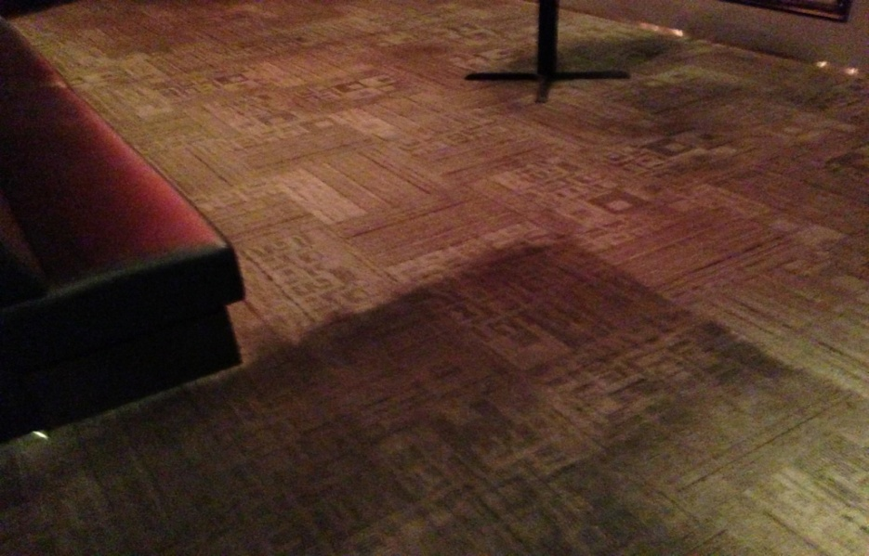
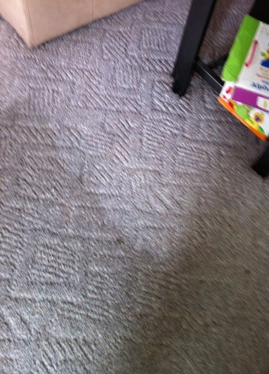
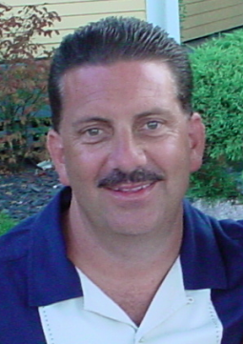
Tag's Dependable Restoration is a
leader in business continuity and
disaster recovery services for
residential, commercial, and
industrial properties. Our services
include 24-hour emergency
response; Carpet cleaning; lead/
asbestos removal & mold
remediation; bio-hazard clean-up;
contents cleaning & restoration;
pack-outs and reconstruction;
Carpet installation & Repair. Our projects range from minor jobs such as restoration & reconstruction of a single room in a private residence to large losses requiring environmental remediation, demolition and reconstruction of major commercial operations.
John Tagliarini - Owner 216-650-4099
E-mail: johntagliarini@aol.com
VISIT NEW WEBSITE at JtagCo.com http://savocaprod.wix.com/jtagco
*Mention Logan Wells – get Special free
scotchgard treatment with minimum of
3 rooms cleaned!!
JtagCo.com

Slide 6

www.loganwells.com
Logan Wells Productions
PO Box 33453
Cleveland, OH 44133
440-582-3996 office
John Tag – Management 216-650-4099 cell
email: SavocaProd@aol.com
facebook: Logan Wells, Cleveland, OH
**This email is intended for Logan Wells fan club/ business associates email list....if you wish to be removed from this weekly mailing, please send a reply email with "please remove" in the subject line. Thank you.

